Slide 1

MedEval: G-Eval for Clinical Summarization
Harini Varanasi 11747338 Akhila Madanapati 11710780 Anjali Bheemireddy 11659436 Drashti Miteshkumar Mehta 11686504

Slide 2
Introduction
Why the Need for Clinical Summarization?
In medical settings, accurate and brief summaries of clinical notes matter for the safe and efficient decision-making.
Limitations Related to Traditional Evaluation:
Metrics like ROUGE and BLEU are unable to take contextual accuracy, coherence, completeness and actionability into account, and the particular case in point is complex medical text.
What MedEval does?
It considers LLMs (e.g., LLaMA-2, Mistral 7B) to evaluate generated clinical summaries through a more human-centered approach rather than through simple lexical overlap.

Slide 3
Base Paper
G-Eval: NLG Evaluation using GPT-4 with Better Human Alignment
This publication collects results on the using GTP-4 to model human judgment in evaluating generated texts. It is found to show more agreement with human evaluators in terms of fluency, relevance, and coherence.

Slide 4
Existing Methodology
Traditional Metrics: ROUGE, BLEU, METEOR
Focus on word overlap, not meaning
Poor alignment with clinical relevance
• Limitations:
- Miss context and logical flow
- Fail to capture medical accuracy
G-Eval Approach:
- GPT-4 with Chain-of-Thought (CoT) prompting
- Evaluates based on clarity, correctness, completeness
- Closer to human judgment

Slide 5
Proposed Methods
Dataset: MIMIC-III (Electronic Health Records from ICU patients)
Preprocessing:
Extracted key files: ADMISSIONS, DIAGNOSES_ICD, PROCEDURES, PATIENTS
Filtered data by subject_id and hadm_id
Gathered ICD-9 codes and procedures for summarization input
Summary Generation:
Used LLaMA-2 and Mistral-7B with structured prompts
Included clinical sections like Chief Complaint, HPI, and Hospital Course
Evaluation with G-Eval:
Used Chain-of-Thought (CoT) prompts to guide LLM self-evaluation
Evaluated summaries on: Clinical Accuracy, Completeness, Readability, Actionability
Scoring: 0–10 with justification for each dimension

Slide 6
Hypothesis
1. To evaluate MedEval for its performance in estimating clinical text summarization. 2. To compare performance of Mistral 7B, Llama 7B using MedEval. 3. To make recommendations for improving evaluation frameworks for use in clinical NLP.

Slide 7
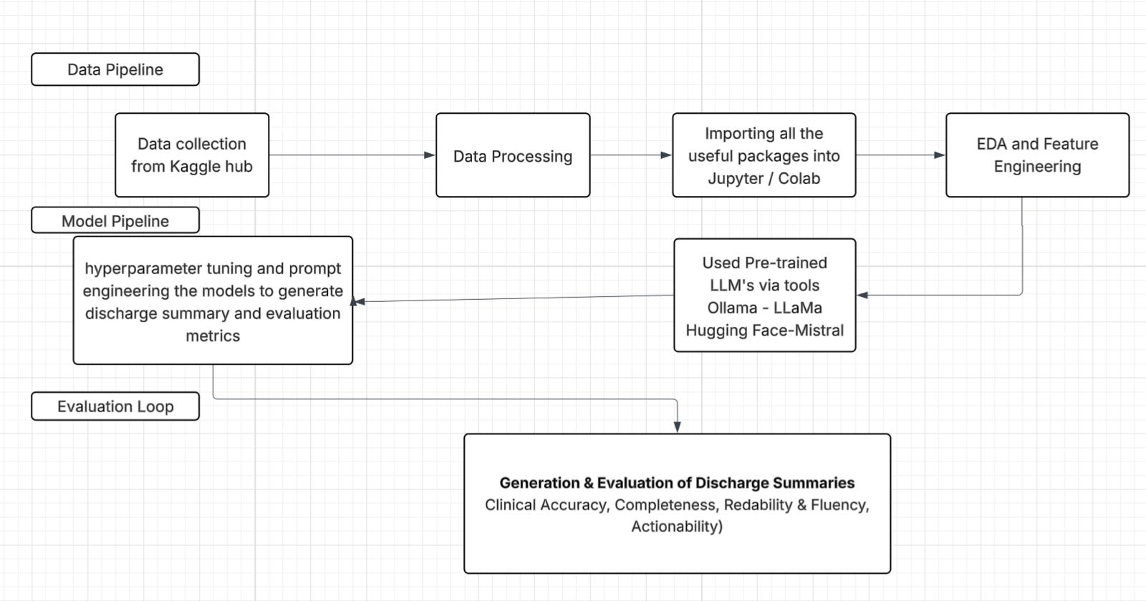
System Architecture

Slide 8
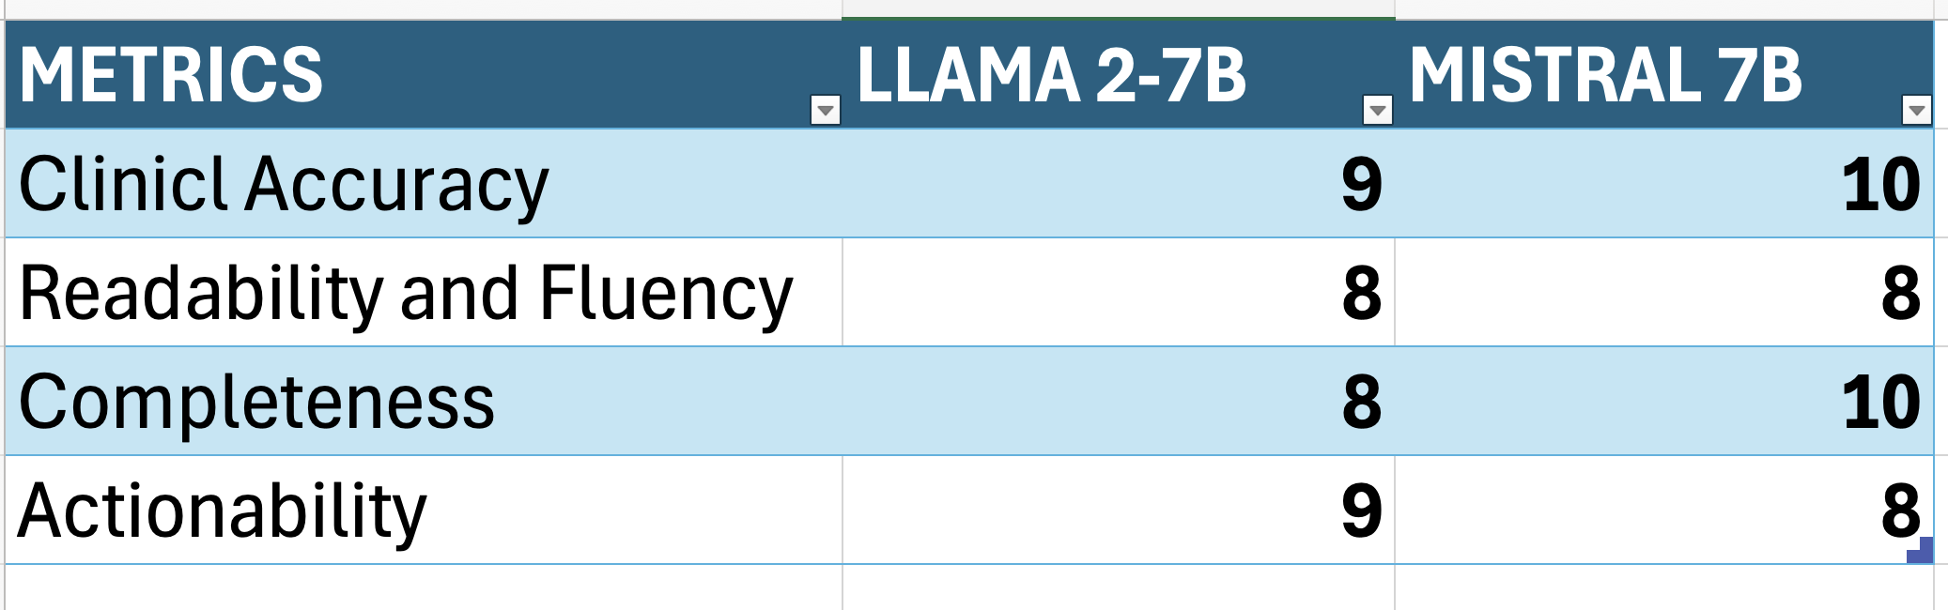
Results

Slide 9
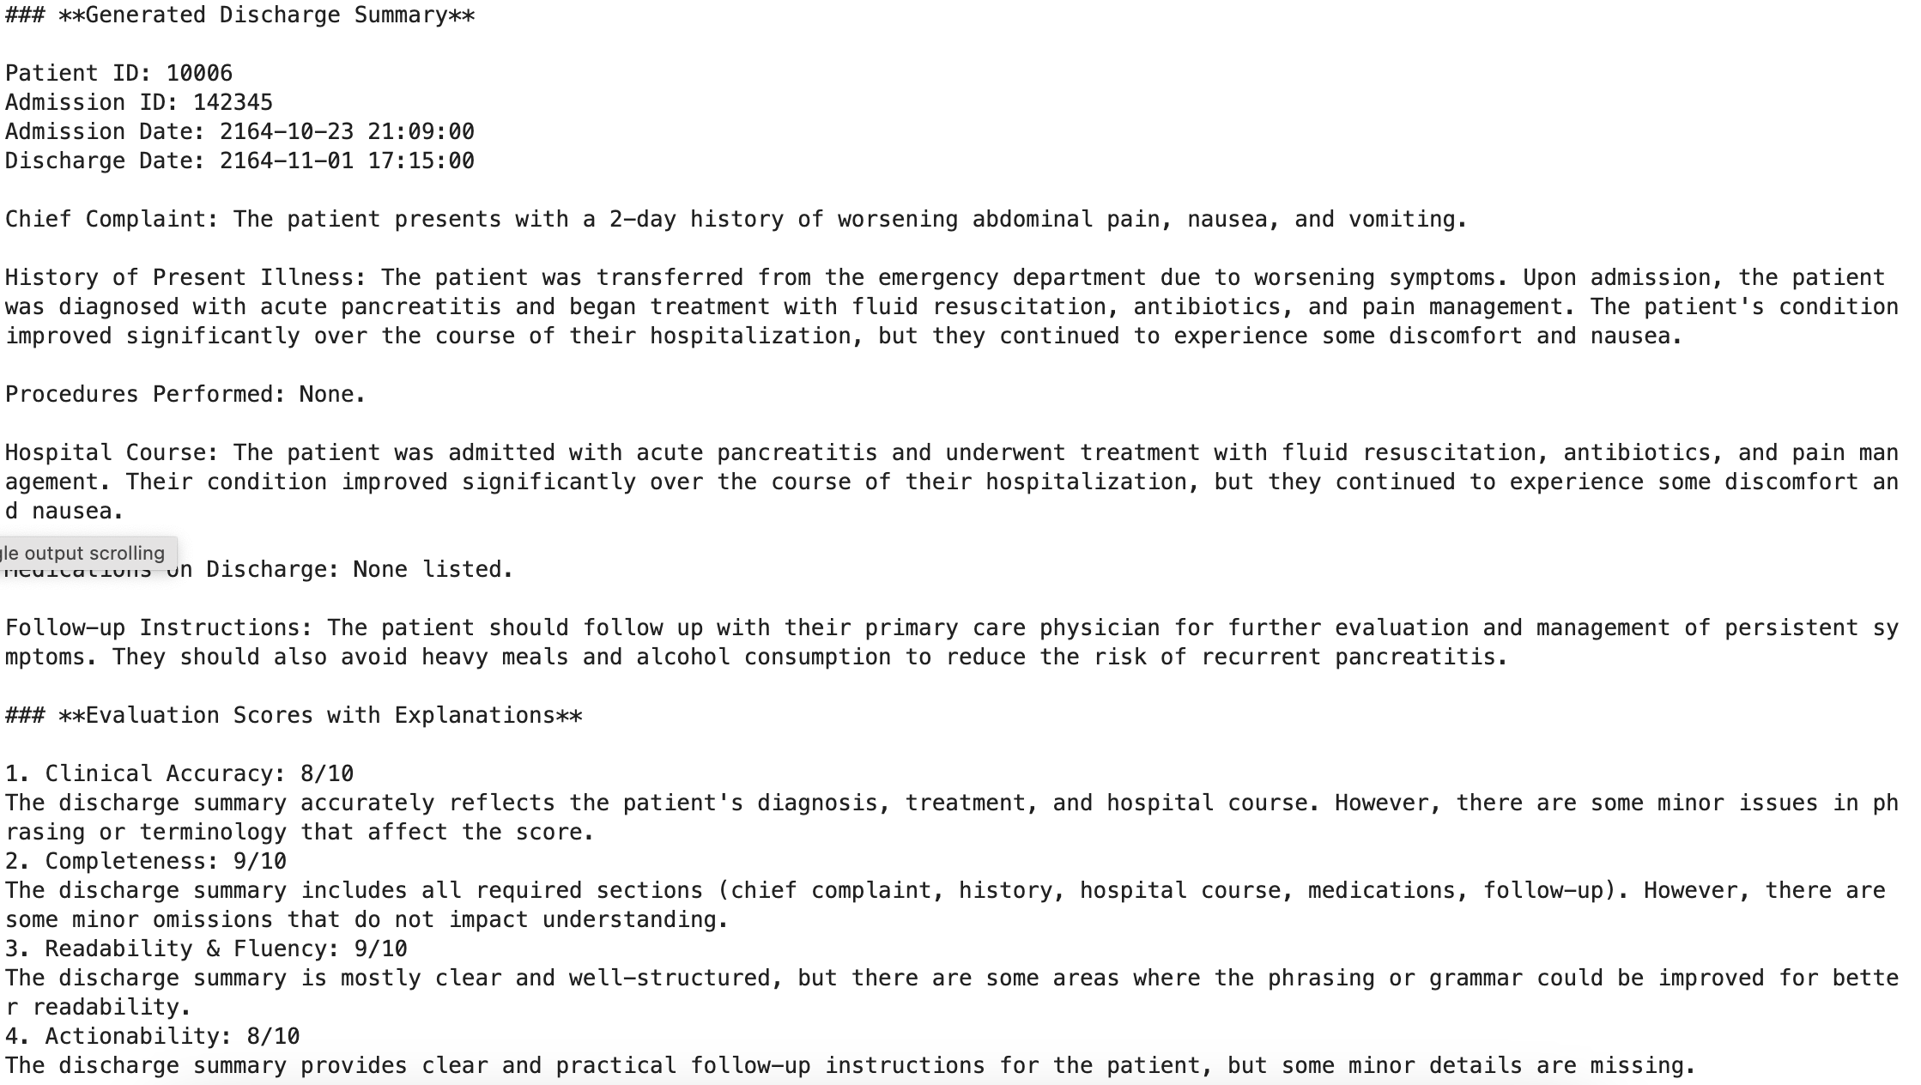
Llama2 –7B Output

Slide 10
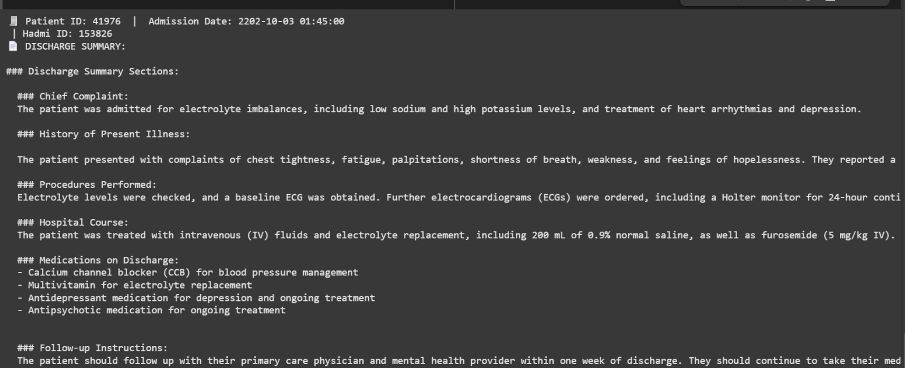
Mistral 7B Output

Slide 11
Code
Llama - Google Colab for Llama
Mistral 7b - Google Colab for Mistral 7b

Slide 12
Contributions
Harini- Conducted a thorough literature review and selected the base research paper to guide model development. Contributed to data collection efforts, ensuring data quality and relevance. Selected and contributed to coding and implementation of the LLaMA2 7B model using Ollama for optimal performance and relevance to project goals. Explored alternative models to compare performance.
Akhila-Contributed to research phase in selecting models, Worked on implementing Bigpt and Clinical BERT for medical text summarization, addressing tokenization and input length challenges. Contributed on creating system architecture and documentation.

Slide 13
Contributions
Drashti - Led the implementation of the Mistral-7B model for clinical text summarization, focusing on crafting effective prompts and generating high-quality discharge summaries. Conducted thorough performance analysis using G-Eval metrics to evaluate clarity, completeness, and correctness of the outputs. Also explored alternative models like Google Flan, which generated summaries that lacked clinical precision and failed to return evaluation metrics, leading to its exclusion. Additionally contributed to documentation, interpretation of results, and model refinements based on statistical insights to support the final evaluation pipeline.
Anjali- Actively contributed to research and design by reviewing literature and identifying suitable methodologies. Assisted with data preprocessing to structure clinical records for model. Collaborated on Mistral-7B implementation, focusing on prompt engineering and tuning. Explored alternative models like ClinicalBERT and T5, though limited by token constraints. Supported evaluation using G-Eval and helped refine both summaries and evaluation workflow.

Slide 14
Future Work
Include probability scoring function on the scores generated
Test MedEval on LLMs which are fine tuned for clinical summarization.

Slide 15
References
Liu, Y., Iter, D., Xu, Y., Wang, S., Xu, R., & Zhu, C. (2023). G-eval: NLG evaluation using gpt-4 with better human alignment. arXiv preprint arXiv:2303.16634.

